Slide 1
Autism (ASD) and the Educational Environment
Randi Chapluk, Principal, Riverside County Office of Education

Slide 2
True or False
My child has a diagnosis of ASD, so he will receive specialized services at school

Slide 3
False
Having a medial diagnosis of ASD does not mean an individual requires specialized services and/or modifications to access the educational environment.

Slide 4
Autism in the educational setting
Medical Diagnosis
Educational Eligibility
Can only be given by a doctor or other specially trained clinician using criteria set forth by the DSM-5
Might mean your child is eligible for special education services
A team of professionals, which includes the child’s parent, determines a student is eligible by both being identified as meeting at least one of the disability categories and be in need of specialized services under IDEA
Autism is one of the identified disability categories

Slide 5

Educational eligibility
Eligibility under the category of Autism in the educational environment is the impact of the disability on learning.

Slide 6
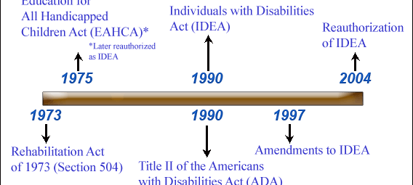
Federal Legislation Timeline
https://iris.peabody.vanderbilt.edu/

Slide 7
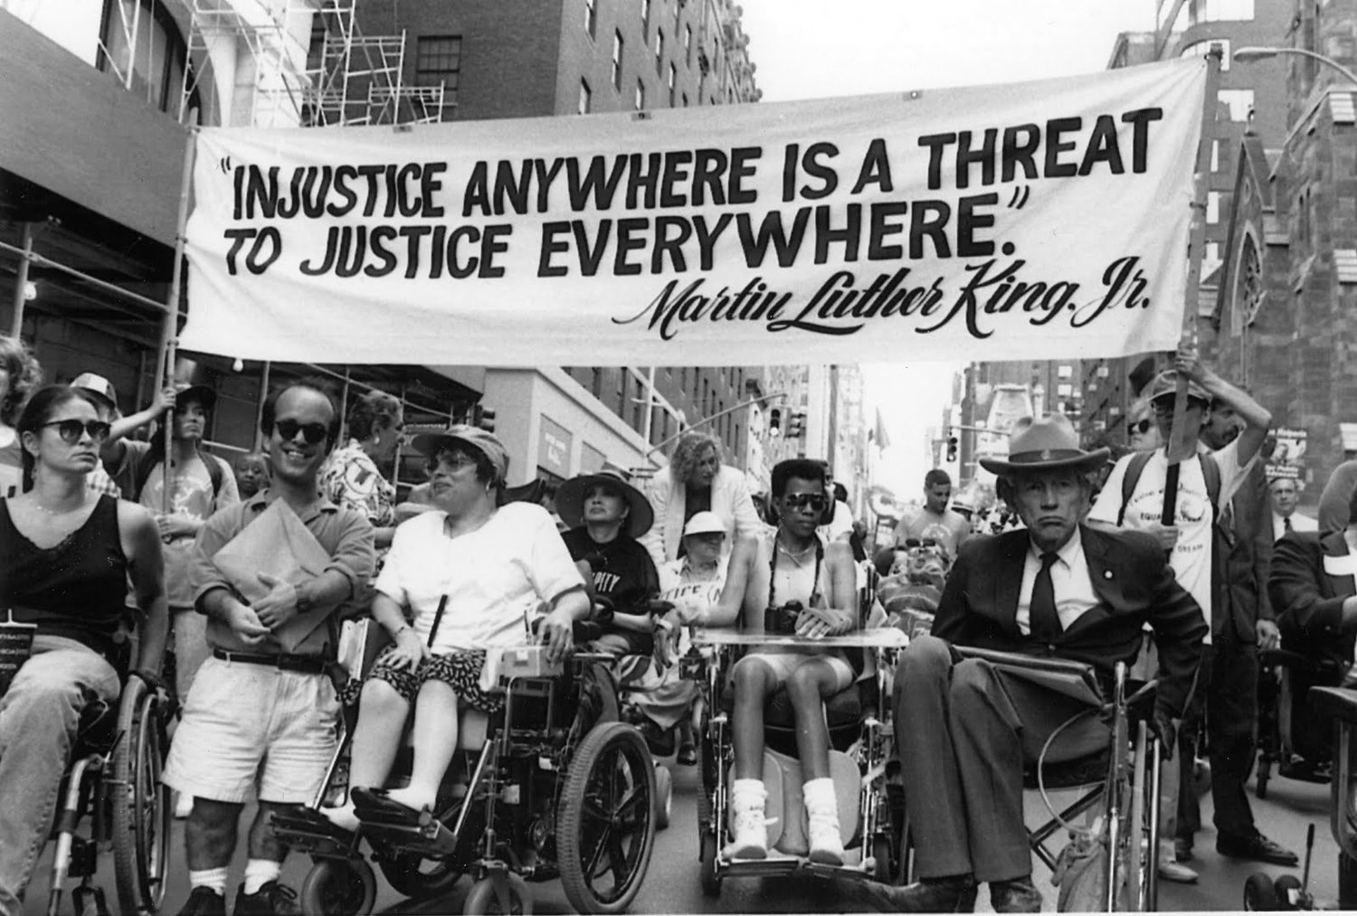
Rehabilitation Act of 1973, Section 504
A civil rights law which prohibits discrimination of individuals with disabilities in programs and activities which receive federal funding.
Americans with Disabilities Act (ADA) of 1990
A law which guarantees equal opportunity for individuals with disabilities in employment, public accommodations, transportation, state and local government services, and telecommunications

Slide 8
IDEA and IDEIA (Individuals with Disabilities Educational Improvement Act, 2004)
Rights
Protections
Free Appropriate Public Education (FAPE)
Least Restrictive Environment (LRE)
Supplementary aides and services, aka Related Services
Assessment
Due Process
Individualized Education Program (IEP)
Part C of IDEA
Authorizes assistance to address the needs of infants and toddlers

Slide 9

Multiple paths to support individuals with ASD in the educational setting:
Child Find
A legal requirement that public schools find all children who have disabilities and may be eligible for special education services, birth to 21
EC §300.11
Includes homeschooled children and students enrolled in private school
School team
Family:
Requests a Student Study Team (SST)
Requests evaluation in writing

Slide 10
https://www.rcselpa.org/resources/uploads/files/Guide%20for%20Parents%20and%20Guardians%20English.pdf

Slide 11
Student Study Team (SST)
A legal requirement of general education that must occur prior to a referral for special education
Is a group of individuals at the school site who analyze data, identify interventions specific to a student, and re-meet to evaluate the data to determine efficacy
Who is included?
The team will include: the student’s parent(s) and teacher. Often an administrator and other professionals who know the student will attend

Slide 12

IEP Meeting
Frequency
Notice of Meeting
Who is in attendance?
Procedural Safeguards

Slide 13
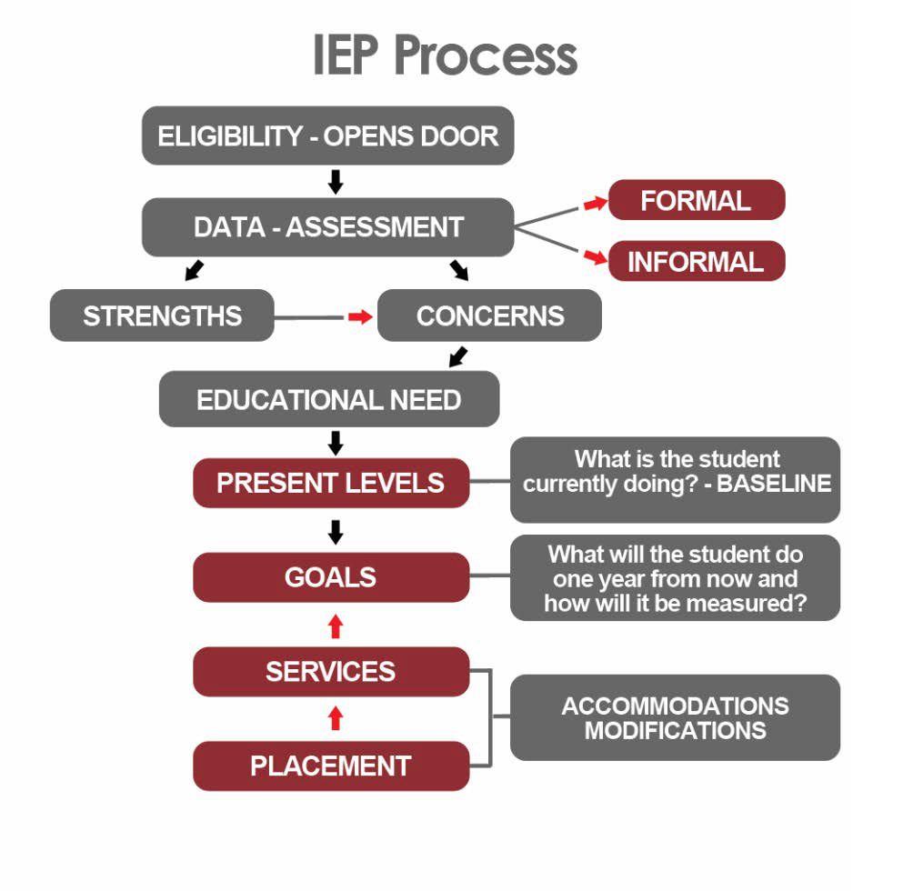
DM SELPA

Slide 14
Eligibility Review of data to determine present levels and eligibility
Eligible
Not Eligible
IEP process continues
May be eligible for a 504 plan
Student is referred to SST

Slide 15
Accommodations vs. modifications? Neither is defined under IDEA, however an understanding of the difference is crucial in determining a pathway of support for individuals in the educational environment
Accommodations
Modifications
A strategy utilized to support an individual in accessing the information in the curriculum/standards
Examples can include:
Extra time to complete an assignment
Enlarged text
Provision of notes
Extra prompts or visuals
Preferential seating
Adjusting class schedule
A strategy used to modify the curriculum to make it accessible to an individual, in other words, it changes the standard
Examples can include:
Modified workload
Word bank of choices for test questions
Targeting one portion of a standard rather than the whole standard

Slide 16
504 plan
In the educational environment, a student does not have both a 504 plan and an IEP
Not all students with disabilities require specialized instruction
General education function
Federally protected document that can continue after the student’s public education experience
Specifies accommodations to ensure success and access to the learning environment
Should be updated annually

Slide 17

Eligible Development of IEP Goals
Goals are identified in identified areas of need
Driven by the present levels of performance
Wrightslaw.com

Slide 18
Continuum of services and placement

Slide 19
Local Educational Agency (LEA) offers FAPE
Parent must provide consent prior to implementation of IEP
Notification of progress
In line with general education progress reports
IEPs are held
Initial, annual, triennial, transition

Slide 20

Strategies that can be used to work with the school program to support the success of my child

Slide 21
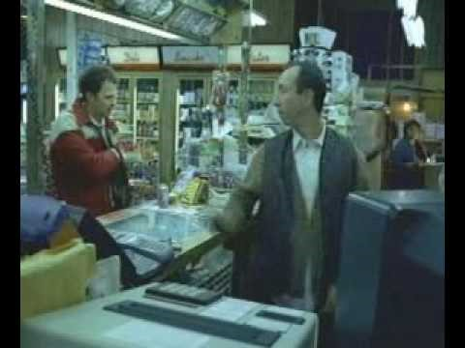
Communication & Collaboration

Slide 22
Resolving Conflict
Riverside County SELPA

Slide 23
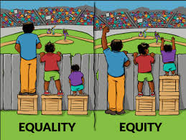
interactioninstitute.org and madewithangus.com

Slide 24
Resources
Riverside County Special Education Local Plan Area (SELPA) “A Special Education Guide for Parents and Guardians”
https://www.rcselpa.org/resources/uploads/files/Guide%20for%20Parents%20and%20Guardians%20English.pdf

Slide 25
Q & A

