Slide 1
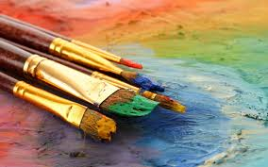
Feel Better with Art
Notes:
Introductions by class members- list any involvement in art/crafts/hobbies/ past or present
Color Personality test for Icebreaker

Slide 2
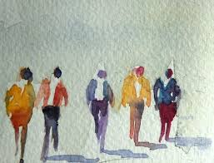
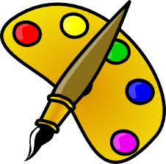
Art Therapy
Three of the Benefits of doing Art
Brain Activity
Self-care
Mental Health & Well-being
Research & Studies
Brain Tune-Up
Visual Art Study
PEARLS
Suggestions for Art Activities
Supplies you may already have at home
Art demonstration

Slide 3
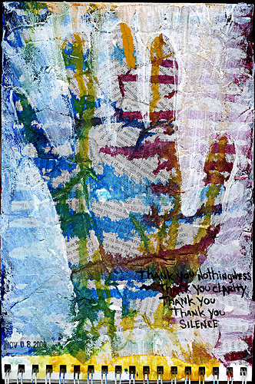
Art is a therapeutic activity that helps you Feel Better
Versus Art Therapy
Art therapy is offered by health care professionals
with backgrounds in both art and psychology or counseling
Consider Art Therapy if you are experiencing:
High-stress
Mental health disorder
Learning disability
Brain injury
Chronic illness
Very useful for children and teens, PTSD, depression
Psychology Today has a search tool to find an art therapist in your area

Slide 4
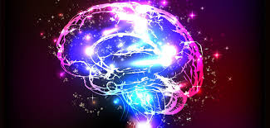
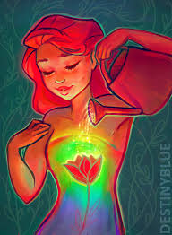
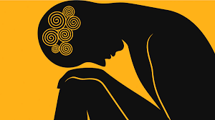
Three Important Prongs that Art promotes:
1. Brain Activity
2. Provides Self-Care
3. Increases Positive Mental Health & Well-being

Slide 5
Promote Brain Activity
Promotes self-awareness
Relieves stress, anxiety and confusion through a sense of empowerment
Increases socialization when done with others
Helps to cope with transitions
Facilitates communication
Stimulates self-expression of feelings
Enhances memory care and creative thinking
Improves motor and cognitive skills
Art boosts self-esteem
And Creative pursuits provide a sense of accomplishment
(Deane Alban, 2018)

Slide 6
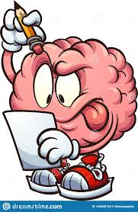
Doing art involves getting both hemispheres of your brain communicating with each other.
Boosts your drive, focus, and concentration
Stimulates the brain to grow new neurons
Every time you engage in a new or complex activity, your brain creates new connections between brain cells.
Your brain’s ability to grow connections and change throughout your lifetime is called brain neuroplasticity.
Neuroplasticity: Your brain can change by forming new brain cells and neural connections, improving its capabilities throughout your life.

Slide 7
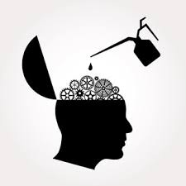
Research
Brain Tune Up
A study done by Dr. Arnold Bresky, who created a program called “Brain Tune Up” which utilized art therapy with Alzheimer’s and Dementia patients, showed a 70% success rate in improvements in his patients’ memories.
(Deane Alban, 2018)

Slide 8
What is Self-Care?
Notes:
Brain Storm what it is and WHY do it

Slide 9
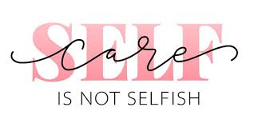
Self-Care means doing things that help you manage the day-to-day stress so that it doesn’t build up too much.

Slide 10
Art for Self-Care
No matter what your ability level or amount of experience, art making has been shown to lower cortisol (stress hormone) levels.
Creating Art Relieves STRESS!!
Offers relaxation
Can become a new Hobby
Eases the burden of chronic health conditions
Art lets a person forget about their illness or struggles for a while, allowing for a focus on positive life experiences
Creating art enables people to maintain a connection to who they were before they got sick (or injured or traumatized).
(Deane Alban, 2018)

Slide 11
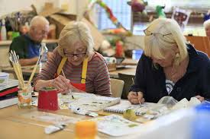
Increases Positive Mental Health & Well-being
Creating art is an effective way to stimulate the brain and anyone can do it.
Activities like painting, sculpting, drawing, and photography are relaxing and rewarding hobbies that can lower your stress level and leave you feeling mentally clear and calm.
Creating art provides a distraction, giving your brain a break from your usual thoughts.
The average person has 60k thoughts per day and 95% of them are exactly the same, day in and day out!
When you get immersed in a creative endeavor, you may find yourself in what’s known as “the zone” or in a state of “flow”.
(Deane Alban, 2018)

Slide 12
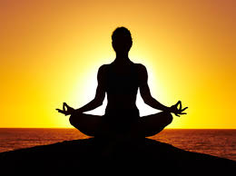
Increases Positive Mental Health & Well-being
Creating art increases the “feel good” neurotransmitter dopamine (Deane Alban, 2018).
Dopamine stimulates the creation of new neurons and prepares your brain for learning
Leonardo da Vinci said, “Painting embraces all the ten functions of the eye; that is to say, darkness, light, body and color, shape and location, distance and closeness, motion and rest.”
Creating art trains you to concentrate on detail and pay more attention to your environment, which in a way acts like mediation.
Art hobbies of all kinds: knitting, quilting, sewing, drawing, photography, woodworking, gardening, and Do-It-Yourself (DIY) home repair ALL increase dopamine, which wards off depression and promotes healthy aging of the brain.
(Deane Alban, 2018)

Slide 13
The Connection Between Art, Healing, and Public Health
A Visual Arts Study, by: Stuckey & Noble, 2010
Art helps people express experiences that are too difficult to put into words. Some people with illnesses explore the meanings of past, present, and future during art therapy, thereby integrating said illness into their life story and giving it meaning.
Many chronic diseases are associated with psychosocial difficulties such as depression and chronic stress, contributing to negative cardiovascular outcomes. Engagement with creative activities has the potential to contribute toward reducing stress and depression and can serve as a vehicle for alleviating the burden of chronic disease.

Slide 14
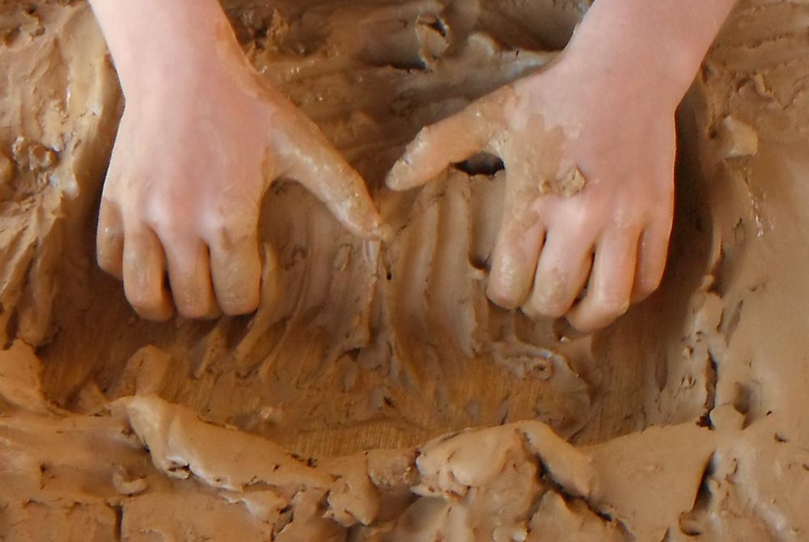
Art can be a refuge from the intense emotions associated with illnesses. There are no limits to the imagination in finding creative ways of expressing grief. In particular, molding clay can be a powerful way to help people express these feelings through tactile involvement at a somatic (feeling) level, as well as to facilitate verbal communication and psychological release.

Slide 15
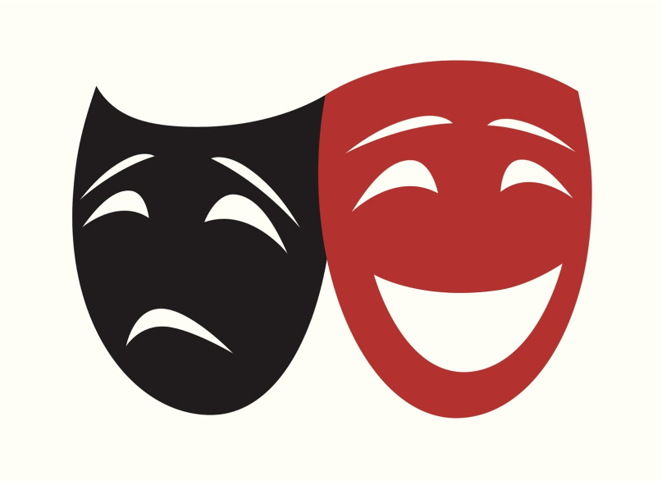
When you find yourself feeling not so good…
It is normal to experience feelings of sadness, loneliness, or “the blues” from time to time
There may be times when it becomes more difficult to shake off those feelings and we could start feeling stuck in a cycle
These feelings can be seen as symptoms, like a cold, that can be addressed before they increase

Slide 16
PEARLS
New program at ICRC
FREE!
Individuals 60 years and older living in Riverside County
Evidence-based program that focuses on decreasing the symptoms of depression and increasing the quality of life
Works with participant in their home/community
As of April 2020 sessions are offered virtually by phone & video
Building problem-solving skills
Help recognize the link between depressive symptoms and current problems
Increasing social, physical, and other pleasant activities
“Do more, feel better”
Program to Encourage Active and Rewarding Lives for Seniors
1-800-675-6694

Slide 17
Suggested Art Activities
Color for calmness
Use art as a form of therapy by taking the time to color these pages with positive messages. Download and print the coloring page files here.
Use any available art supplies (crayons, coloring pencils, markers, etc.)
Color alone or and invite others in your household (children and adults) to color with you.
Cooking , Baking, Photography, Ceramics, Recycle Art, Knitting, Food art
Music, Mosaic, Scrap Booking, DIY projects, Sidewall Chalk Art,
Any writing (creative writing, poems, journals, story telling
Any and all activities require your creativity
Wood carving & burning. Candle making, gardening, Rock painting
Decorating (frig, room, seasonal decorating, Home made greeting cards
Make-up makeovers, face painting

Slide 18
Art Supplies & Ideas
Any writing supplies (markers, crayons, colored pencils, pens, chalk, etc..)
Make-up
Any paint (water, acrylic, oil, nail polish, house paint, spray paint, ink etc..)
Toilet paper rolls
Yarn, string, needles, beads, buttons, gems, ribbons
All types of paper (line, color, construction, tissue, etc..)
Textile, felt, fabric, foam
Brushes (any type)
Glues / Glue gun, glue stick
Scissors, copper wire, any wire
Dry Food (macaroni, beans, rice,
Sparkles & glitter
Rocks
Wood, wood carving tools, wood burner
Flowers, leaves
Magnets
Candles, wax
Old t-shirts
Gardening tools

Slide 19

HOPE RELAXATION JOY GRATITUDE TRANSFORMATION
PAINT UNTIL YOUR HEART
IS CONTENT!
Notes:
Right and left brain discussion---how this helps

Slide 20
References
Alban, Deane. (2018). The Mental Health Benefits of Art Are for Everyone. Be Brain Fit.
Bebrainfit.com
Noble, J. MD. & Stuckey, H. L. (2010). The Connection Between Art, Healing, and Public Health:
A Review of Current Literature. Public Health.
https://www.ncbi.ni.gov/pmc/articles/PMC284629/

