Slide 1
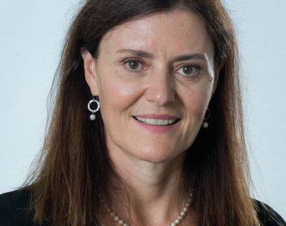
Endometriosis and pelvic pain in transmasculine and gender non-conforming individuals
Shanti Mohling, MD
Pearl Medical Center
Portland, Oregon

Slide 2
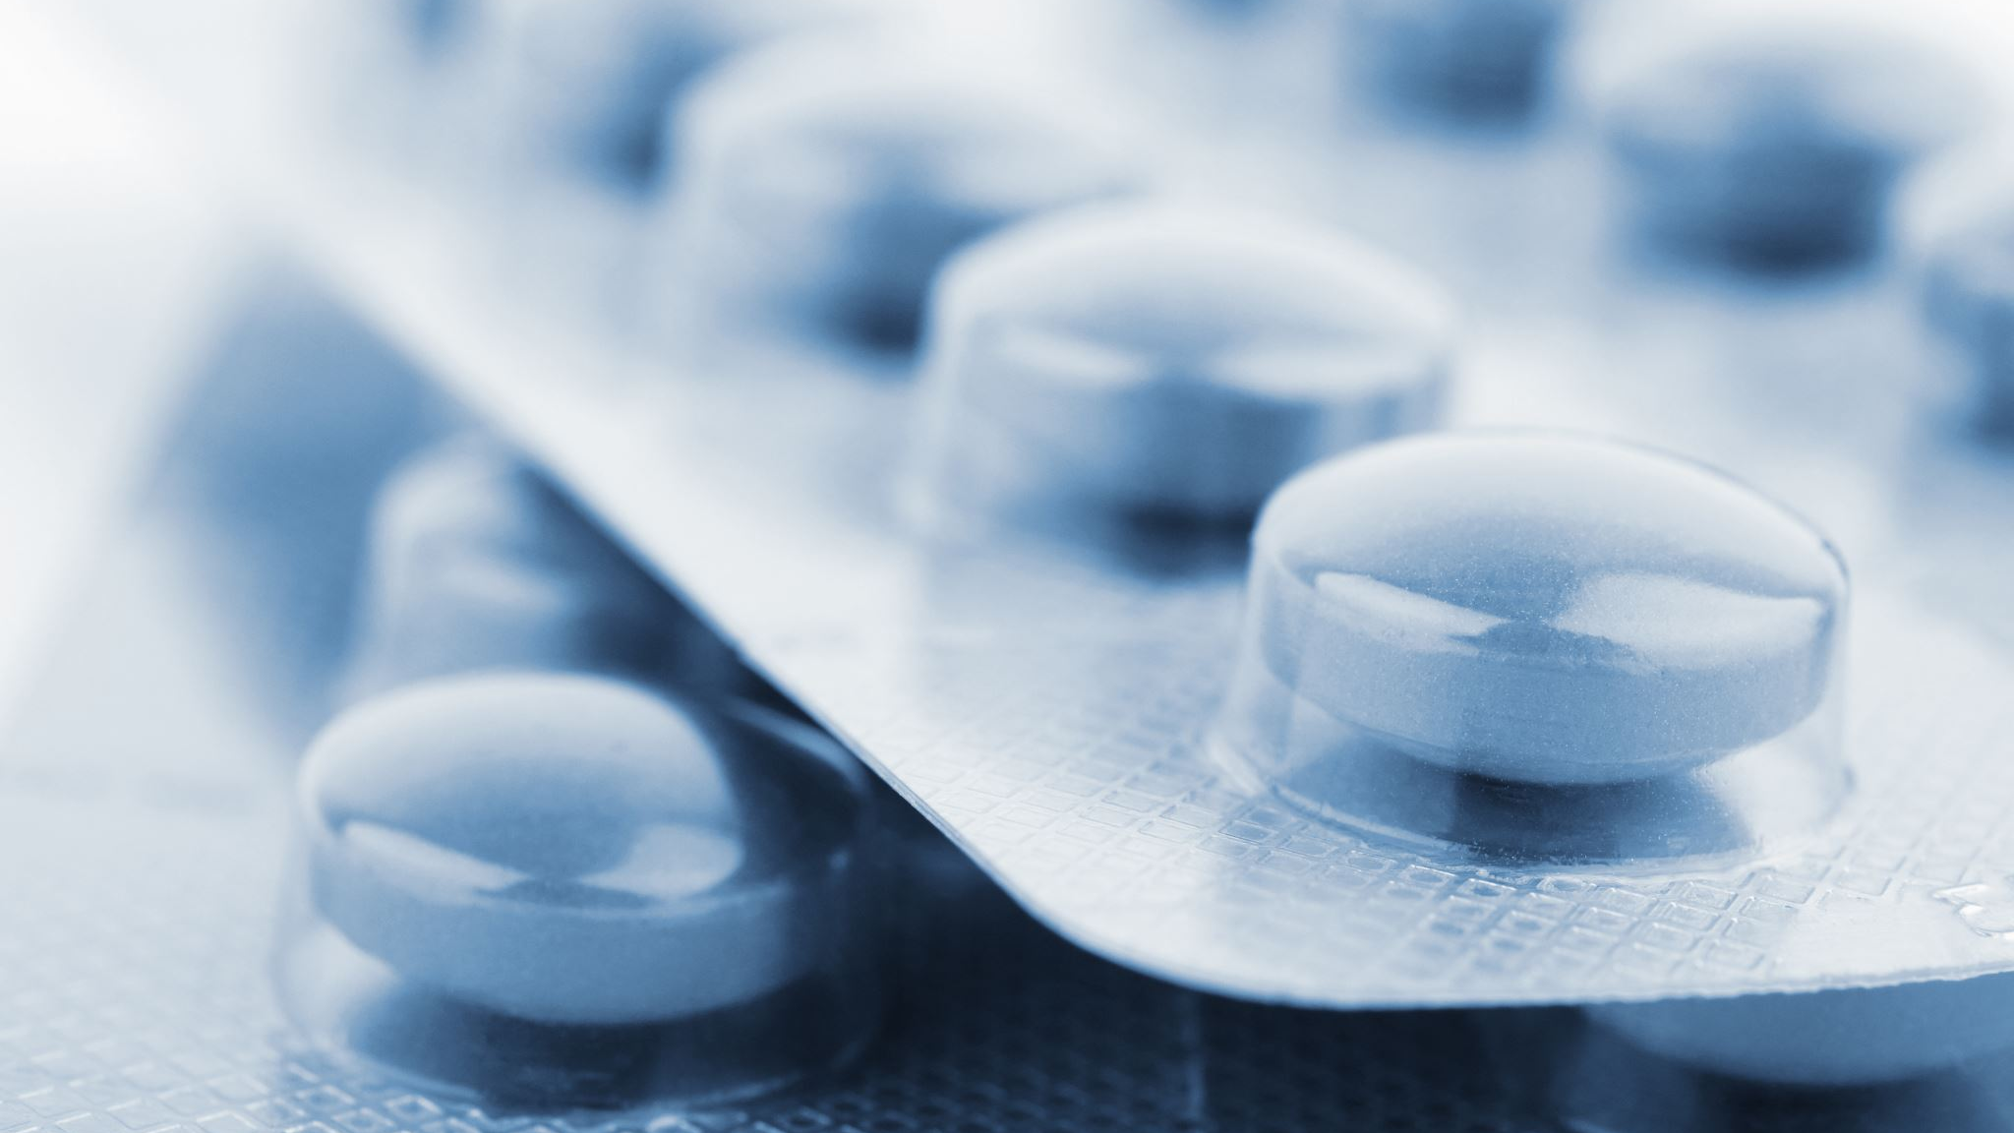
Nothing to disclose. I do not accept funding from pharmaceutical companies or medical industry.

Slide 3
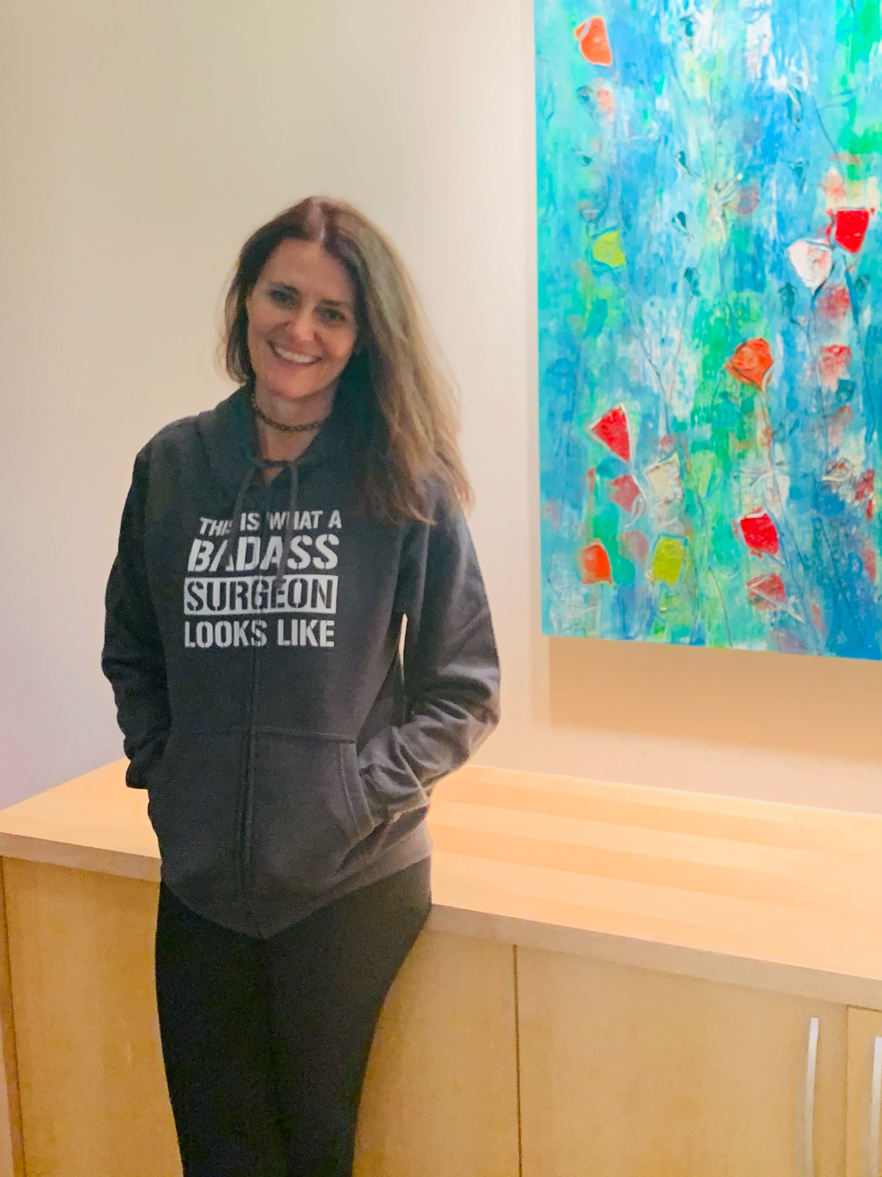
My background
Residency at University of Colorado, Denver
15 years in general OB/GYN practice in New Mexico
Fellowship-trained in MIGS in Chattanooga, Tennessee
Former Associate Director, MIGS Fellowship and Former Director of Gynecology for OB/GYN residents at University of Tennessee in Chattanooga
Currently: Director of Gynecology, Pearl Medical Center in Portland, Oregon
Notes:
And the personal part of my background is that I was a massage therapist while I put myself through school to get all my premedical requirements.

Slide 4
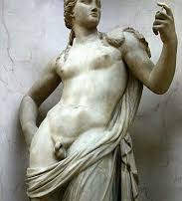
Definitions
Gender Identity: Fundamental gender identity.
Transgender: Gender identity differs from sex assigned at birth.
Cisgender: Gender identity is the same as sex assigned at birth.
Gender dysphoria: Gender identity and sex assigned at birth are different and this creates distress
Notes:
Marfori CQ, Wu CZ, et al. Hysterectomy for the Transgendered Male: Review of Perioperative Considerations and Surgical Techniques with Description of a Novel 2-Port Laparoscopic Approach. JMIG. 2018 Dec;25(7), 1149-1156.

Slide 5
Pelvic pain and discrimination
Cis-women with pelvic pain still face an uphill battle trying to be heard and receive appropriate care for pain and endometriosis.
Transmasculine and gender non-conforming individuals with pelvic pain have a magnified version of this
Notes:
In my experience as a gynecologist I have noted over the past 25 years that Cis-women also have a hard time being heard regarding their pelvic pain. Practitioners generally don’t like dealing with pain. It makes us feel helpless and uncomfortable.
Add to that a discomfort in dealing with gender issues and gender non-conformity and you end up with a slice of the population who have very real health issues and few providers comfortable taking care of them.

Slide 6
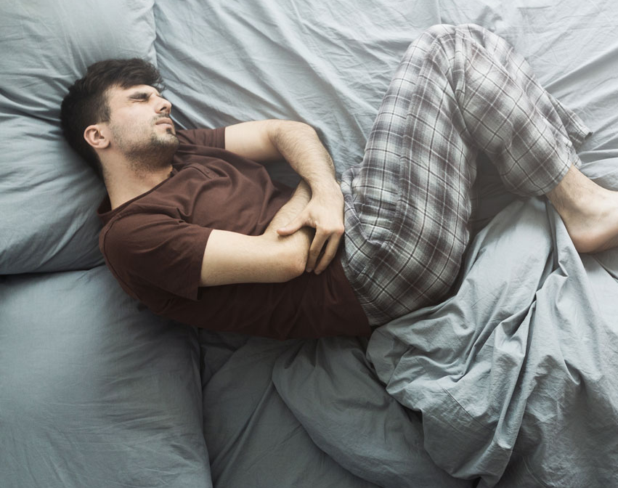
Some uncomfortable statistics:
19% of trans people have been refused care due to their gender identity
28% have been subjected to harassment in a medical setting
Almost half of trans people have delayed medical attention due to discrimination (28%) or inability to afford it (48%).
Notes:
Our talk today is mostly about transmasculine persons and GNC individuals who were FAAB and have pelvic pain, abnormal bleeding and/or endometriosis. We will touch on transfeminine pain issues at the end.

Slide 7
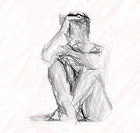
Transmasculine and GNC with pelvic pain face an added challenge
Their pain may be misappropriated to gender dysphoria
Many practitioners are either unfamiliar with transgender care or uncomfortable with it
Global lack of understanding among practitioners regarding care of pelvic pain in general
Notes:
In my experience as a gynecologist I have noted over the past 25 years that Cis-women also have a hard time being heard regarding their pelvic pain. Practitioners generally don’t like dealing with pain. It makes us feel helpless and uncomfortable.
Add to that a discomfort in dealing with gender issues and gender non-conformity and you end up with a slice of the population who has very real health issues and few providers comfortable taking care of them.

Slide 8
Initial evaluation is not unlike that for Cis-females
PCOS
Pelvic infection
Interstitial cystitis
Gastrointestinal issues (IBS, colitis)
Myofascial issues
Endometriosis and adenomyosis
Pregnancy related problems (tubal pregnancy)
Ovarian cysts and masses
While Psychological issues may contribute, they should not be blamed as the source of pain

Slide 9
Traditional chronic pelvic pain work-up
History
Exam
Labs and cultures
Ultrasound
Sometimes MRI or CT scans
Notes:
See my other webinar for details on my traditional workup

Slide 10
Specific problems for transmasculine and GNC
Impact of Testosterone dosing
Atrophic tissues and cervicitis or vaginitis: Inflammation of the “front hole”
Chronic Sexually transmitted infection
Musculoskeletal pain resulting from genotypically female bone structure combined with muscle mass changes from Testosterone
Notes:
Testosterone lowers estrogen causing atrophy of the vaginal tube and increases the pH

Slide 11
The issues that often seem to be overlooked in transmen and GNC
Endometriosis
Adenomyosis

Slide 12
New onset abdominal and pelvic pain following initiation of Testosterone Therapy
70% had new onset pain after initiation of testosterone (Gender Affirming Hormone Therapy GAHT)
80% had suprapubic pain
1-year from onset of Testosterone to pain
Notes:
Grimstad FW, Boskey E, Grey M. New-Onset Abdominopelvic Pain After Initiation of Testosterone Therapy Among Trans-Masculine Persons: A Community-Based Exploratory Survey. LGBT Health. 2020 Jul;7(5):248-253.

Slide 13
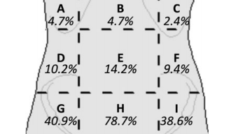
New onset abdominal and pelvic pain following initiation of Testosterone
Pain can be multifactorial
828 of those who had suprapubic pain had hysterectomy and this resolved their pain
Notes:
1 was noted to have IC, 1 had adenomyosis
Grimstad FW, Boskey E, Grey M. New-Onset Abdominopelvic Pain After Initiation of Testosterone Therapy Among Trans-Masculine Persons: A Community-Based Exploratory Survey. LGBT Health. 2020 Jul;7(5):248-253.

Slide 14
New onset abdominal and pelvic pain following initiation of Testosterone
80% had pain in pelvic region, yet diagnosis of endometriosis was not mentioned
Was it even considered?
Notes:
Grimstad FW, Boskey E, Grey M. New-Onset Abdominopelvic Pain After Initiation of Testosterone Therapy Among Trans-Masculine Persons: A Community-Based Exploratory Survey. LGBT Health. 2020 Jul;7(5):248-253.

Slide 15
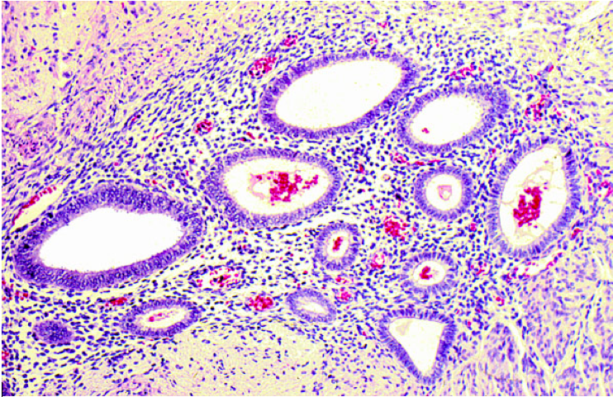
Dysmenorrhea and Endometriosis in Transgender Adolescents
35 adolescents with pain
20% had laparoscopy and all had endometriosis
Notes:
Shim JY, Laufer MR, Grimstad W. Dysmenrorhea and endometriosis in transgender adolescents. J Pediatr Adolesc Gynecol.
Previous studies have demonstrated that a majority of patients stop bleeding after 6 months of testosterone.
“The number of transmasculine adolescents who experienced persistent symptoms, despite taking testosterone, was surprising.” (Shim)

Slide 16
Case #1 (He/him)
24 yo FAAB
Transmasculine on Testosterone
Previously had “top” surgery
Irregular and debilitating painful uterine bleeding while on T
Bleeding caused extreme dysphoria in addition to pain

Slide 17
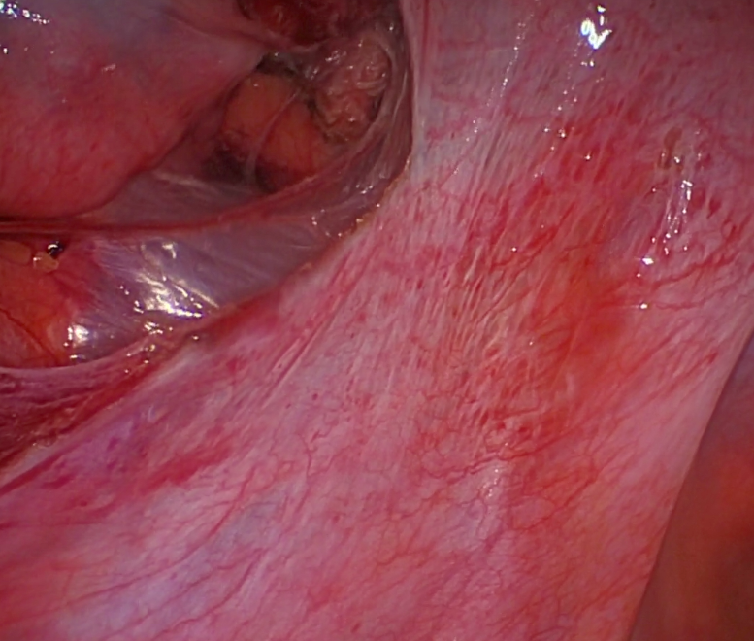
Decision Process
Exam: Endometriosis
Options: Laparoscopic hysterectomy with evaluation for endometriosis and excision, Levonorgestrel IUD, Nexplanon
I did not recommend GnRH agonists or antagonists
Need for pap prior to hysterectomy

Slide 18
It took several weeks to get prior authorization for his procedure
He chose Total Laparoscopic Hysterectomy
Did not have Oregon-based insurance
“Peer to peer” to get authorization
Notes:
NOTES ON GETTING PRIOR AUTHORIZATION FOR HIS PROCEDURE

Slide 19
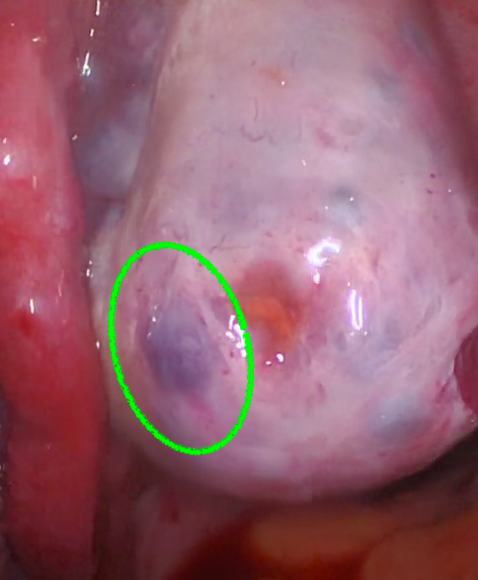
Other considerations for #1
He wanted the left ovary removed
Both ovaries were evaluated at surgery: the right appeared healthy and the left had small endometriomas
Pathology confirmed endometriosis

Slide 20
Transmasculine persons on Testosterone and hysterectomy
23% Persistent bleeding
60% Pelvic pain
Average Testosterone use was 36 months
Notes:
Frances W, Grimstad MD, et al. Uterine pathology in transmasculine persons on testosterone: a retrospective multicenter case series. Am J Obstet and Gynecol, 2019-03-01, Vol. 220

Slide 21
Uterine pathology
70% Active endometrium
7% Adenomyosis
10% Polyps or fibroids
1% Complex hyperplasia
Notes:
Frances W, Grimstad MD, et al. Uterine pathology in transmasculine persons on testosterone: a retrospective multicenter case series. Am J Obstet and Gynecol, 2019-03-01, Vol. 220
Individualized assessments of a transmasculine person’s etiology for abnormal uterine bleeding continue to be necessary, as the risk for concerning pathology is present.

Slide 22
8.5% of transmasculine persons in that study had endometriosis
Notes:
Frances W, Grimstad MD, et al. Uterine pathology in transmasculine persons on testosterone: a retrospective multicenter case series. Am J Obstet and Gynecol, 2019-03-01, Vol. 220

Slide 23
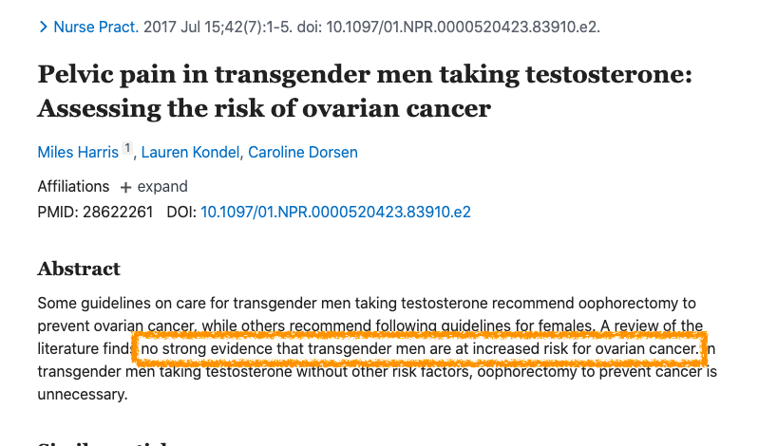
Notes:
Harris M, Kondel L, Dorsen C. Pelvic pain in transgender men taking testosterone: Assessing the risk of ovarian cancer. Nurse Pract. 2017 Jul 15;42(7):1-5.

Slide 24
Risks of removing both ovaries
Menopausal symptoms even with high dose Testosterone
Potential need to take estrogen to prevent symptoms
Notes:
Casimiro I, Cohen RN. Severe Vasomotor Symptoms Post Oophorectomy Despite Testosterone Therapy in a Transgender Man: A Unique Case Study. J Endocr Soc. 2019 Feb 13;3(4):734-736.

Slide 25
After removal of both ovaries:
23% increased Testosterone levels
25% decreased Testosterone levels
44% maintained the same dose
Notes:
Rachlin K, Hansbury G, Pardo ST. Hysterectomy and Oophorectomy Experienes of Female-to-Male Transgender Individuals. Int J Transgenderism 2010 Oct;12(3), 155-166.

Slide 26
Menopausal symptoms
Urogenital atrophy (can include bladder symptoms)
Hot flashes and night sweats
Mood effects with irritability

Slide 27
Benefits of leaving at least one ovary
No known increased risk of ovarian cancer
Future egg-retrieval if procreation desired
NO clear benefit to removal (Does not seem to necessarily effect Testosterone levels)
Prevents menopausal symptoms, especially if there becomes an indication to stop Testosterone for other health reasons
Unknown future ability to obtain HRT
Notes:
Casimiro I, Cohen RN. Severe Vasomotor Symptoms Post Oophorectomy Despite Testosterone Therapy in a Transgender Man: A Unique Case Study. J Endocr Soc. 2019 Feb 13;3(4):734-736.

Slide 28
Case #2 (They/them)
35 y.o. (FAAB)
Gender non-conforming
Masculinized with low-dose testosterone (20 mg IM weekly)
Persistent AUB (abnormal uterine bleeding) and pelvic pain

Slide 29
More about #2
Severe Premenstrual dysphoria
Lifetime of debilitating pain with periods
Painful bowels during periods
Had a trial of GnRH agonist (Orilissa)
Worsened dysphoria and depression
It did not help bleeding or pain
Notes:
Worsened dysphoria and depression to point of suicidal ideation.
It did not help bleeding or pain after 9 weeks.

Slide 30
Work-up for abnormal bleeding
Polyps
Adenomyosis
Fibroids
Malignancy
Coagulation problems
Polycystic ovarian syndrome
Infection
Hormonal imbalance
Notes:
PALM-COEIN from ACOG

Slide 31
#2 History and exam suggested endometriosis
Levonorgestrel IUD (Mirena or Liletta)
Increase Testosterone to suppress bleeding
Laparoscopy and excise endometriosis
Laparoscopic hysterectomy with excision of endometriosis

Slide 32
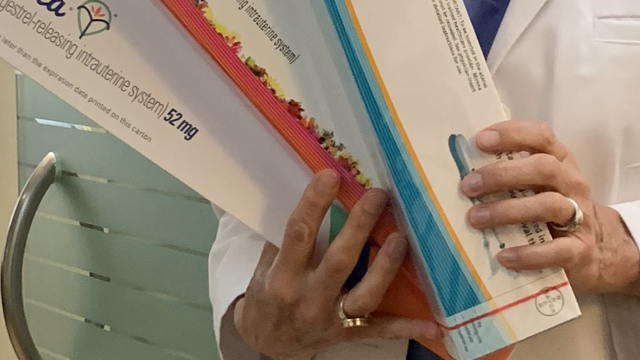
✅They chose to wait on surgery ✅Levonorgestrel IUD ✅They stopped Orilissa ✅At 3-month follow-up they noted significant improvement.
Notes:
Surgery can always be an option later.
Sometimes time is essential in the process of discovery. In their case, the IUD was tremendously helpful in mitigating periods and pain.

Slide 33
Masculinizing effects of Testosterone
Cessation of menses in 2-6 months
Persistent vaginal bleeding can be problematic and may be a sign of too low dosing or other problems
Vaginal Atrophy 3-6 months
Can be a source of pain if vaginal penetration is desired

Slide 34
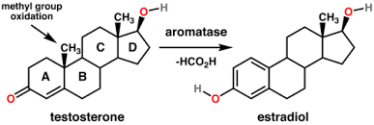
Options for undesired bleeding
Adjust Testosterone dosing
Levonorgestrel IUD (Skyla, Mirena, Liletta, Kylena)
Progestin-only birth control pills
GnRH analogs (Lupron, Orilissa)
Aromatase Inhibitors

Slide 35
FTM transgendered patients are the most socioeconomically disadvantaged group

Slide 36
Interview with Janelle Downing, PhD
The focus of their work: Evaluating access to gender affirming (GA) care in a Medicaid population.
Medicaid covers GA care in 18 states (including Oregon)
Research to show increasing access to care improves health outcomes in trans and GNC population
Notes:
Interview with Jae Downing

Slide 37
What do you see as the greatest barrier to pelvic health care for trans or GNC people?
Lack of access to culturally competent providers (especially in rural areas)
Not getting appropriate referrals to specialists
Discrimination and fears of discrimination
Insurance not covering procedures including diagnosis of “gender dysphoria”
Notes:
Interview with Jae Downing

Slide 38
Interview with Jessica Corman PT, DPT
Works as a Pelvic Floor Physical Therapist
Barriers to care:
Insurance
Education
Providers uncomfortable with Gender spectrum
History of emotional and physical trauma

Slide 39
Transfeminine Pelvic floor pain
Postoperative pain after surgery for neovagina
Pelvic Floor Physical Therapy
Pudendal Neuralgia: Injections vs need for surgical release of nerve
Rule out Interstitial Cystitis

Slide 40
Factors in managing transmasculine persons and pain
Testosterone dosing
Gender dysphoria with bleeding
Ready or not ready for affirmation surgery
Consideration for hysterectomy
Removal of ovaries: yes? No? Keep one?
Role of progestins (IUD or Nexplanon insert) for bleeding
Insurance coverage
Need for contraception in some
➡️ THE IMPORTANT THING IS TO HAVE THE CONVERSATION

